Slide 1

Precipitation in Australia
Overview and Influencing factors
成昊国 42054026
姜萌 42054031
Team_3

Slide 2
Research Questions
Precipitation conditions in various Australian cities (regions).
Variation in rainfall trends in Australia.
Years
Months of the same year
Factors influencing whether or not rain will fall in the Australian cities (regions) tomorrow.

Slide 3
Variable Description of Dataset
Location：The common name of the location of the weather station
MaxTemp：The maximum temperature in degrees Celsius
Evaporation：The so-called Class A pan evaporation (mm) in the 24 hours to 9am
WindGustDir：The direction of the strongest wind gust in the 24 hours to midnight
WindDir9am：Direction of the wind at 9am
WindSpeed9am：Wind speed (km/hr) averaged over 10 minutes prior to 9am
Humidity9am：Humidity (percent) at 9am
Pressure9am：Atmospheric pressure (hpa) reduced to mean sea level at 9am
Cloud9am：Fraction of sky obscured by cloud at 9am, which is measured in "oktas",
Temp9am：Temperature (degrees C) at 9am
RainToday：Boolean: 1 if precipitation (mm) in the 24 hours to 9am exceeds 1mm, otherwise 0
lat, lon: The latitude and longitude of the location
MinTemp：The minimum temperature in degrees Celsius
Rainfall：The amount of rainfall recorded for the day in mm
Sunshine：The number of hours of bright sunshine in the day.
WindGustSpeed：The speed (km/h) of the strongest wind gust in the 24 hours to midnight
WindDir3pm：Direction of the wind at 3pm
WindSpeed3pm：Wind speed (km/hr) averaged over 10 minutes prior to 3pm
Humidity3pm：Humidity (percent) at 3pm
Pressure3pm：Atmospheric pressure (hpa) reduced to mean sea level at 3pm
Cloud3pm：Fraction of sky obscured by cloud (in "oktas": eighths) at 3pm.
Temp3pm：Temperature (degrees C) at 3pm
RainTomorrow：The amount of next day rain in mm

Slide 4
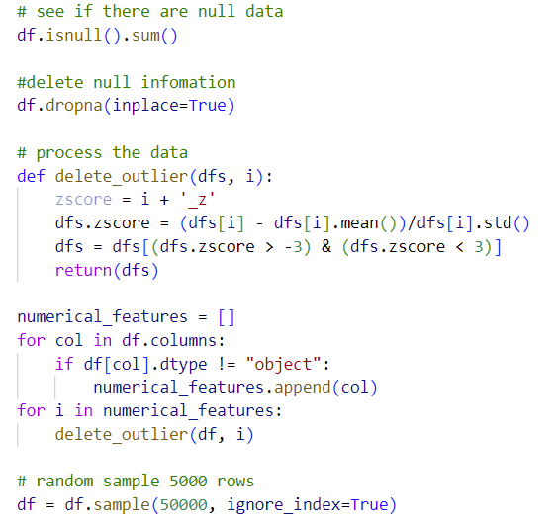
Data Process
Delete the null numbers
Delete outliers
Randomly select 50,000 data

Slide 5
Main functions of the Streamlit Page
Map of regional rainfall in Australia, with a slider which filtered for average rainfall.
Histograms of rainfall by year and by month
The tab blocks show the 9 variables that affect rainfall and the relationship between the variable and the forecast for tomorrow's rainfall in different tabs.
Sidebar which users can enter the names of different areas to see statistics on rainfall at different times of the year and whether it will rain today or tomorrow.

Slide 6
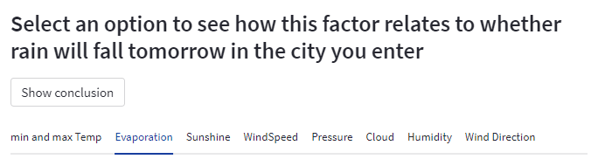
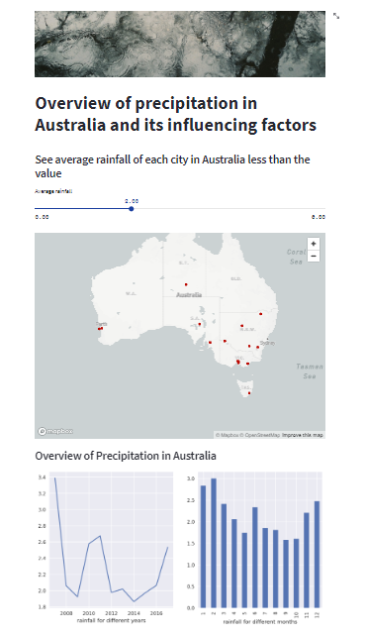
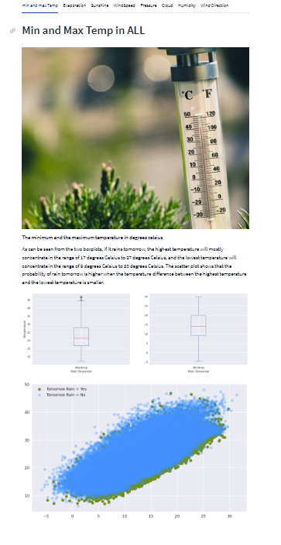
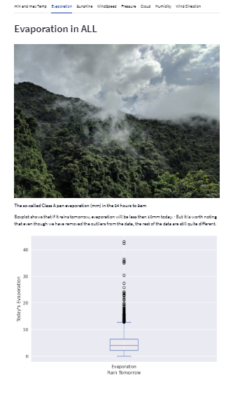
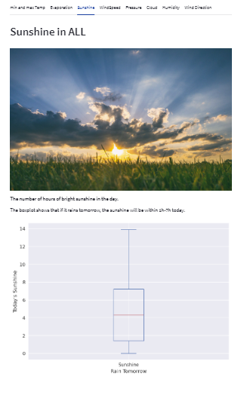
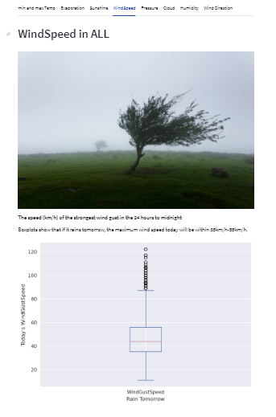

Slide 7
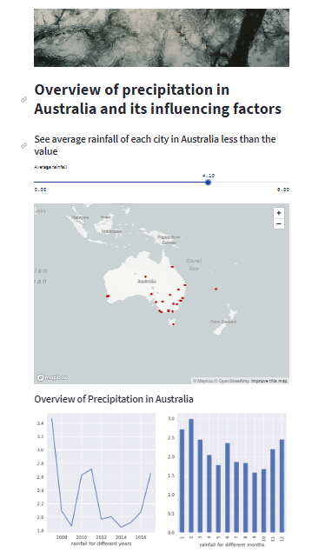
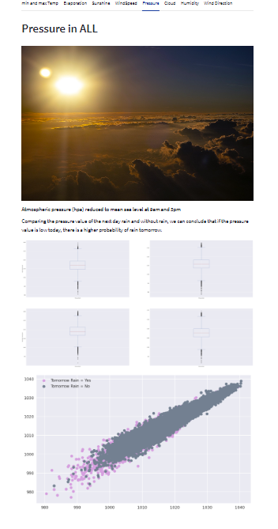
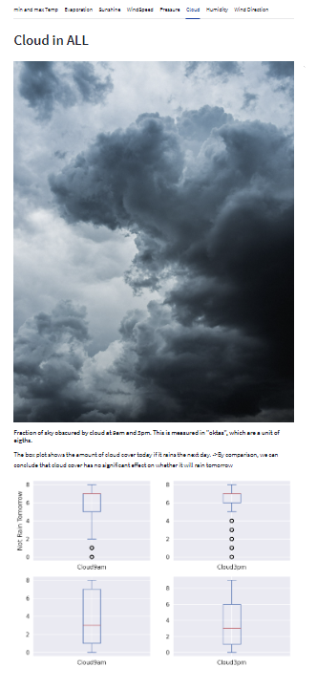
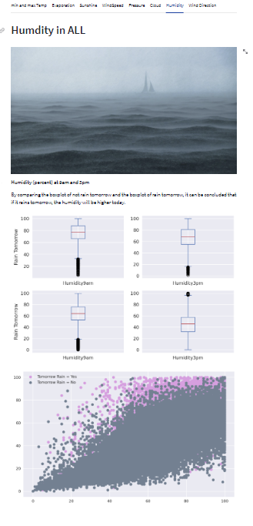
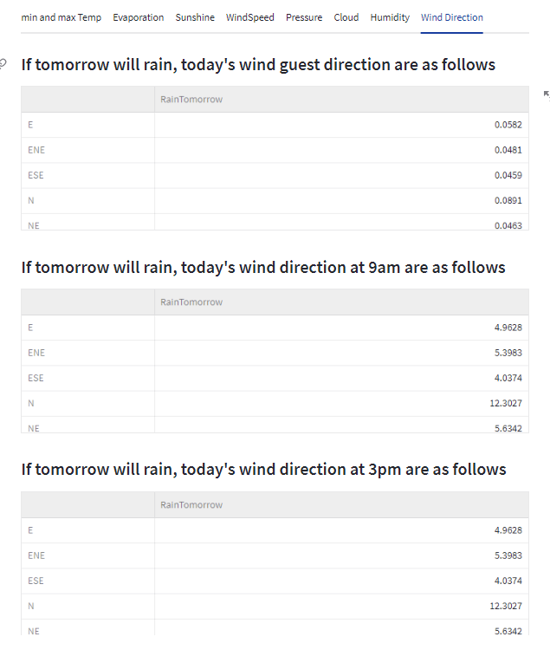

Slide 8
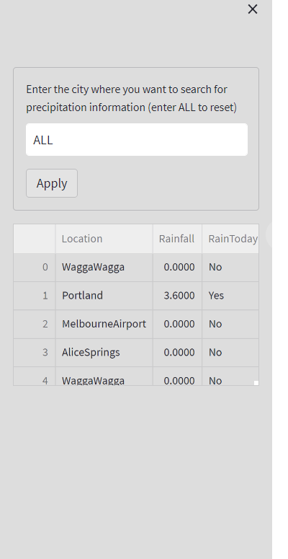
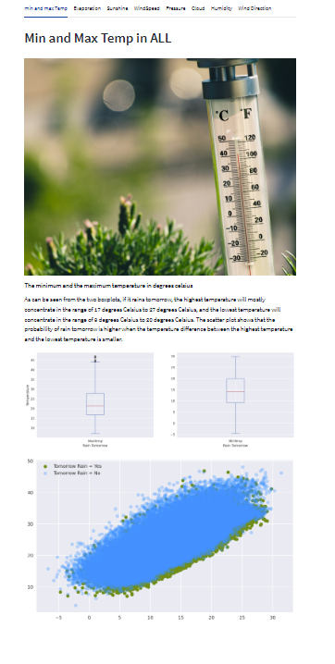
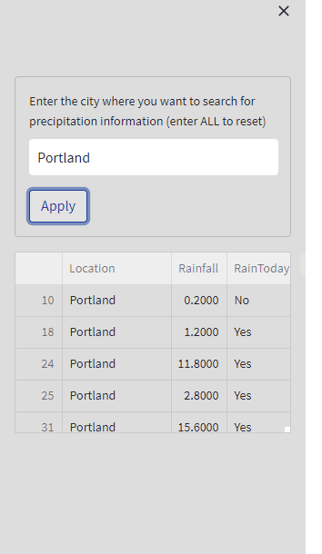
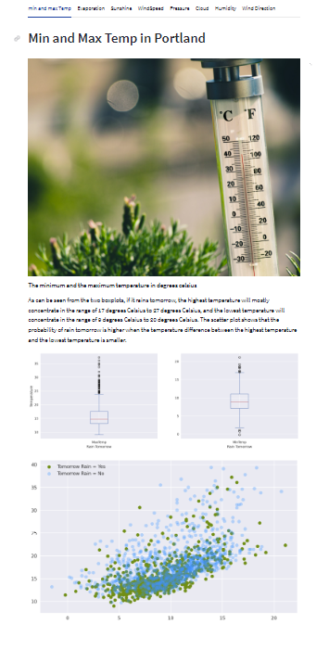

Slide 9
See more information in our pages! https://cao-guo-final-project-app-weather-app-zofvpp.streamlitapp.com/

